Slide 1
Homework 6
Answer all the questions
ME297
SJSU Eradat
Due Thursday Nov. 10

Slide 2
6.1) Rules of thumb
Decisions are made by efficiently applying “rules of thumb” to make quick approximations. Throughout your career, you should make sure to collect these and know how and when to use them (Jim Burge). As part of your homework assignments, you should review the relevant notes and find at least 6 useful rules of thumb from the last week’s lecture notes LN14 – LN15. Report them in the following format.
Name for Rule | Small Angle Approximation
The Rule of Thumb | sin θ ≅ θ (in radians)
When is this used? | This is used for small angles (< 0.2 radians or 11.5⁰) Application of this approximation greatly simplifies analysis and calculation
Limitations | The percent error in the approximation is roughly θ²/6 x 100% so the approximation is valid to < 1% for angles < 0.24 radians (14°) and is valid to 0.01% (100ppm) for angles < 1.4. (you find this by calculating (sin θ – θ)*100 for a range of angles and arguing when if you use it is a situation what kind of error you are signing up for)

Slide 3
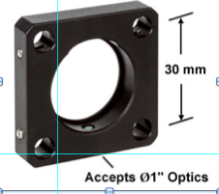
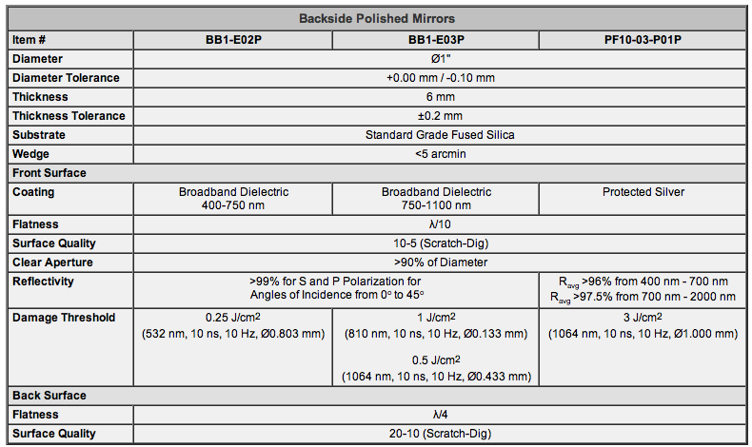
6.2 Mirror mount
This part is not due on Nov. 1st. It is to get started with cad design.
Understand the definition of a datum on a drawing. Make a CAD drawing for the 1” flat mirror mount that use ANSI Y14.5 conventions for dimensioning and tolerancing.
Correctly show dimensions for linear size, diameter, and radii. Make up the numbers and tolerances based on the following most important issues:
Diameter of the optics is 1”
center-to center of the holes is 30mm
Specs of the mirror to be mounted is given in the table. We want to preserve the mirror’s functionality and specs.
Use feature control frames to specify tolerances for straightness, flatness, roundness, profile, perpendicularity, parallelism, concentricity, position, and runout. Define datum references as necessary.

Slide 4
6.3 Kinematic design
What is a kinematic design? Count advantages and disadvantages of it.
Under what condition a design is considered to be kinematic?
Is it possible for a kinematic design to act like a semi-kinematic or no kinematic at all? How?
What is the difference of kinematic and semi-kinematic design
Find an optomechanical product or design that uses a kinematic interface. Provide a drawing of this and a brief description. Discuss the features that make this kinematic. Provide the benefits and limitations of using this particular kinematic constraint. (Any place that sells optomechanical hardware will have numerous kinematic mounts and stages to choose from. You only need one. Hardware for optical design are preferred for this class)

Slide 5
6.4 Solid mechanics
Normal stress, strain and give their relationship.
Shear stress and shear strain. Give their relationship
Poisson ratio
Bulk modulus, and its relationship to E and G
Show the stress – strain curve for a metal
Yield strength
Precision Elastic Limit (microyield strength)
Contact stress and its relations to stiffness and stress
Provide definition of the concepts listed in the next window. Proper drawing would be useful.
Find the SI and common engineering units for each and their relationship. Provide a data table for the common material used in optomechanical design for the cases that apply. Mention the source.

